Slide 1
EDA Assignment 4 Part 1(A)
5420 Anomaly Detection, Fall 2020
- Harsh Dhanuka, hd2457
Article: Improving Fraud and Abuse Detection in General Physician Claims: A Data Mining Study
- Hossein Joudaki, Arash Rashidian, Behrouz Minaei-Bidgoli, Mahmood Mahmoodi, Bijan Geraili, Mahdi Nasiri, Mohammad Arab

Slide 2
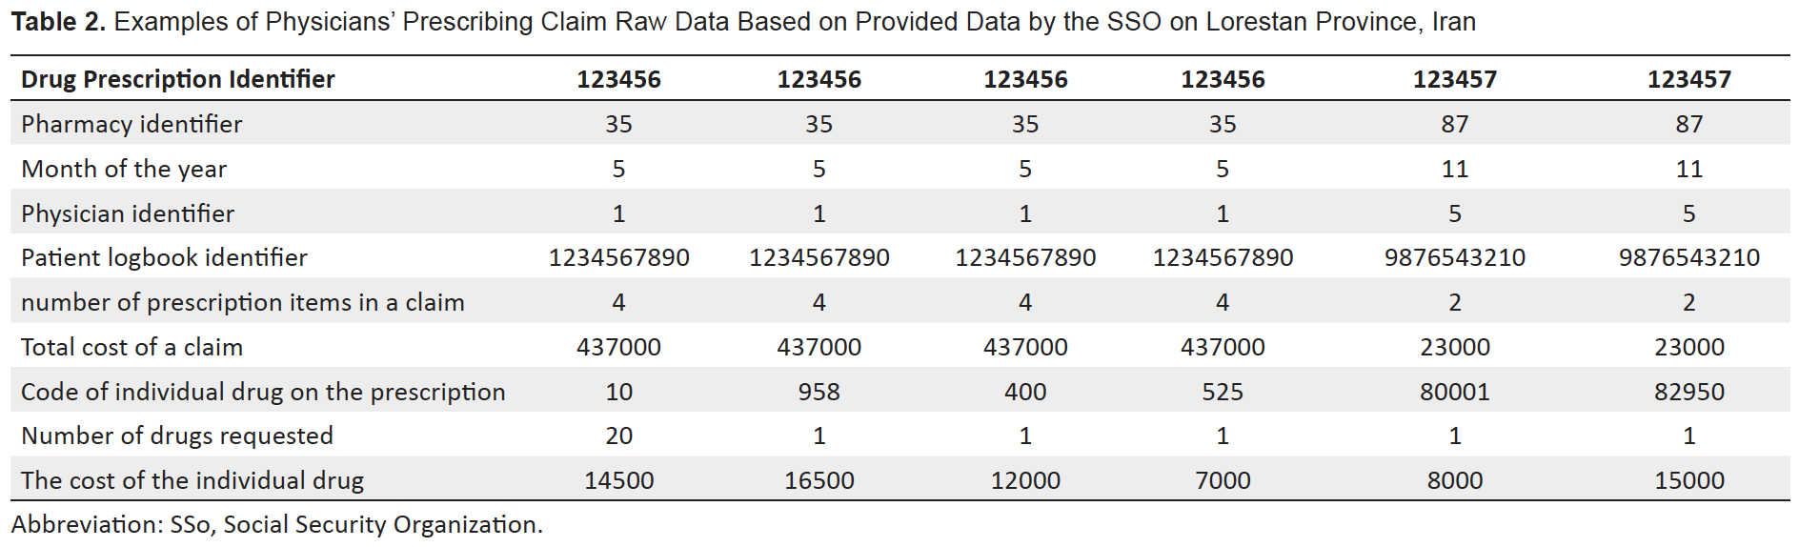
5420 Anomaly Detection, Fall 2020
- Harsh Dhanuka, hd2457
Key Takeaways
1
Around 10% of total health expenditure, which amounts to billions of dollars, is wasted because of fraud & abuse each year.
4
Fraud Detection Model
5-step process to estimate fraud and abuse in Iran Healthcare system:
Nature of problem
Abuse pattern, prescribed more medicines
Fraudulent behavior, collusion between physician and pharmacy
2. Data Preparation
2
Grouping Healthcare Fraud:
Provider Fraud: physicians, Dentists, hospitals
Consumer Fraud: patient / insured
Insurer Fraud
Such interventions involve identifying past and new cases of fraud as quickly as possible after a fraud has been committed.
3

Slide 3
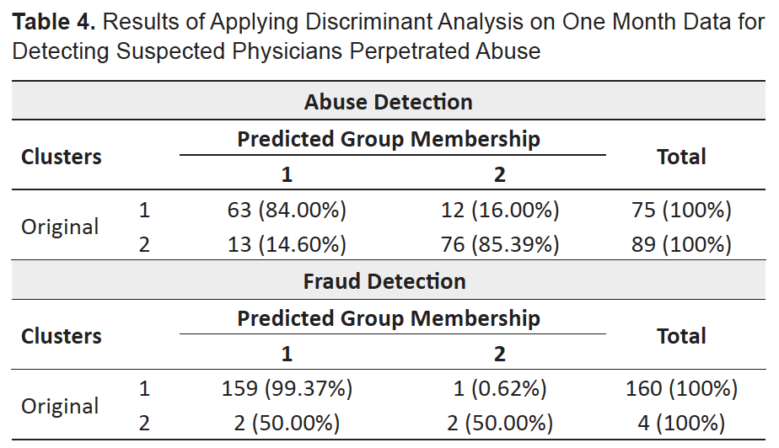
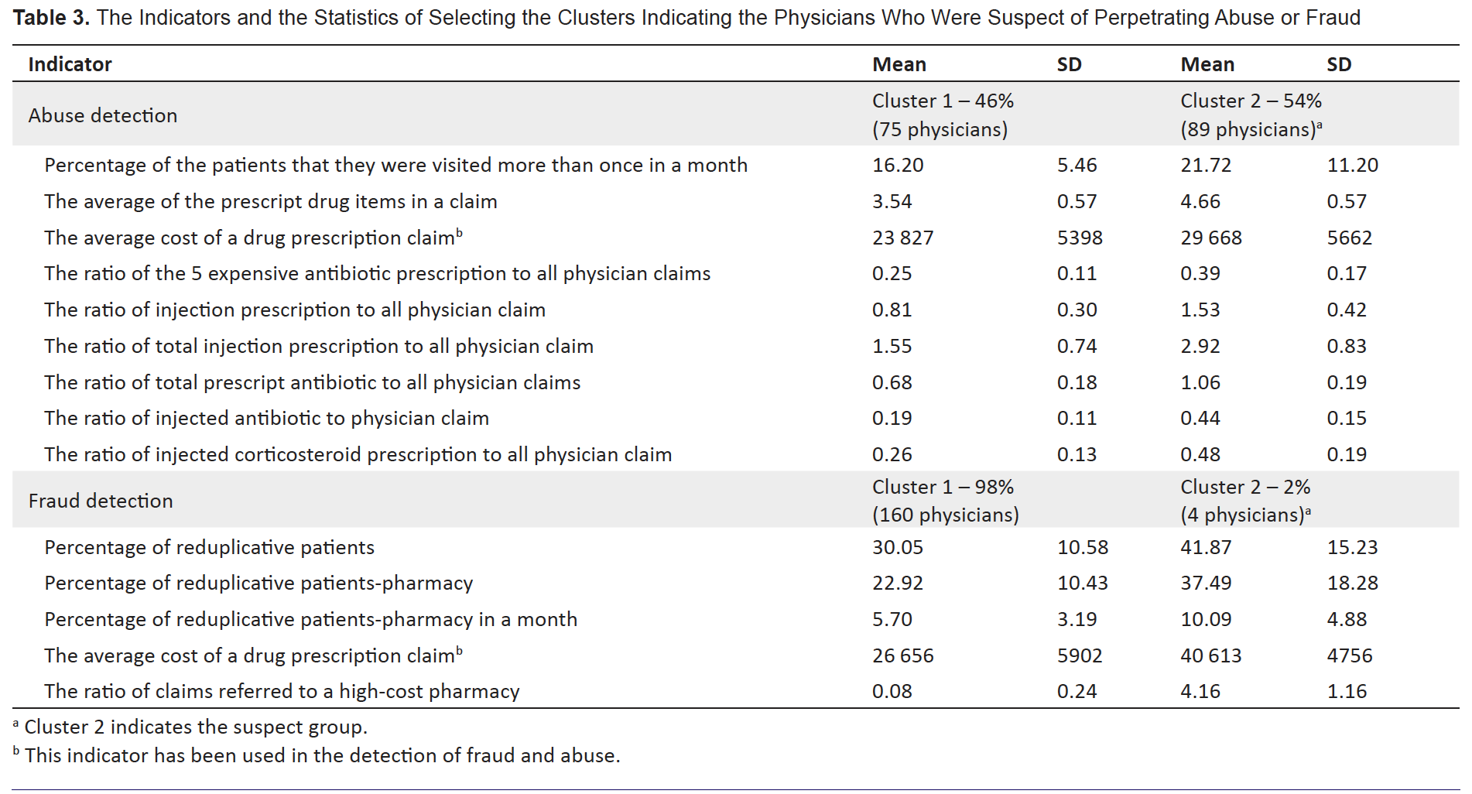
5420 Anomaly Detection, Fall 2020
- Harsh Dhanuka, hd2457
Key Takeaways
5. Discriminant Analysis
3. Feature Engineering
4. Clustering
Hierarchical clustering
Calculate Euclidian distance measures
Number of clusters determined using silhouette coefficient
The discriminant analysis was applied on the remaining one month data that showed 98.17% (161 out of 164) of original clustered cases were correctly classified.
Future considerations
If data exists, the addition of patients’ age, gender and primary diagnosis of disease can improve the performance of data mining in targeting certain subgroups of patients.
Notes:
The analyses identified a large proportion of the physicians as suspect of abusive behavior. The results also identified a small proportion (just over 2%) of physicians as suspects of conducting the fraudulent behaviors of interest. Our approach will help the insurance organizations to focus their limited resources for combating potential frauds on the limited number of physicians with suspicious behavior, and use the results of detailed assessments to decide about the required further actions.

Slide 4
EDA Assignment 4 Part 1(b)
5420 Anomaly Detection, Fall 2020
- Harsh Dhanuka, hd2457

Slide 5
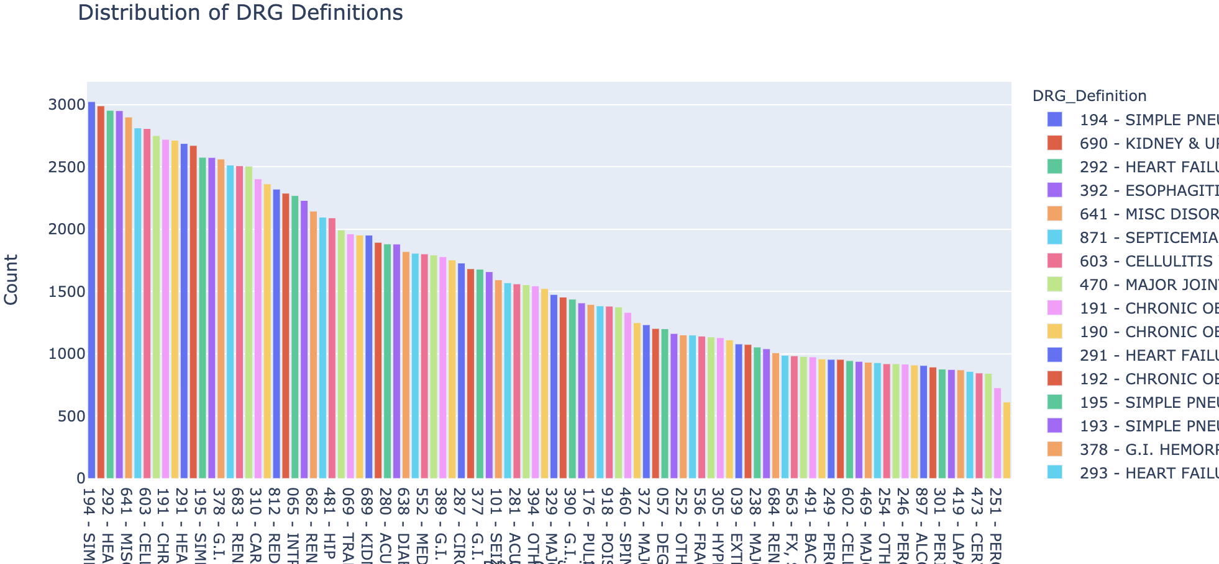
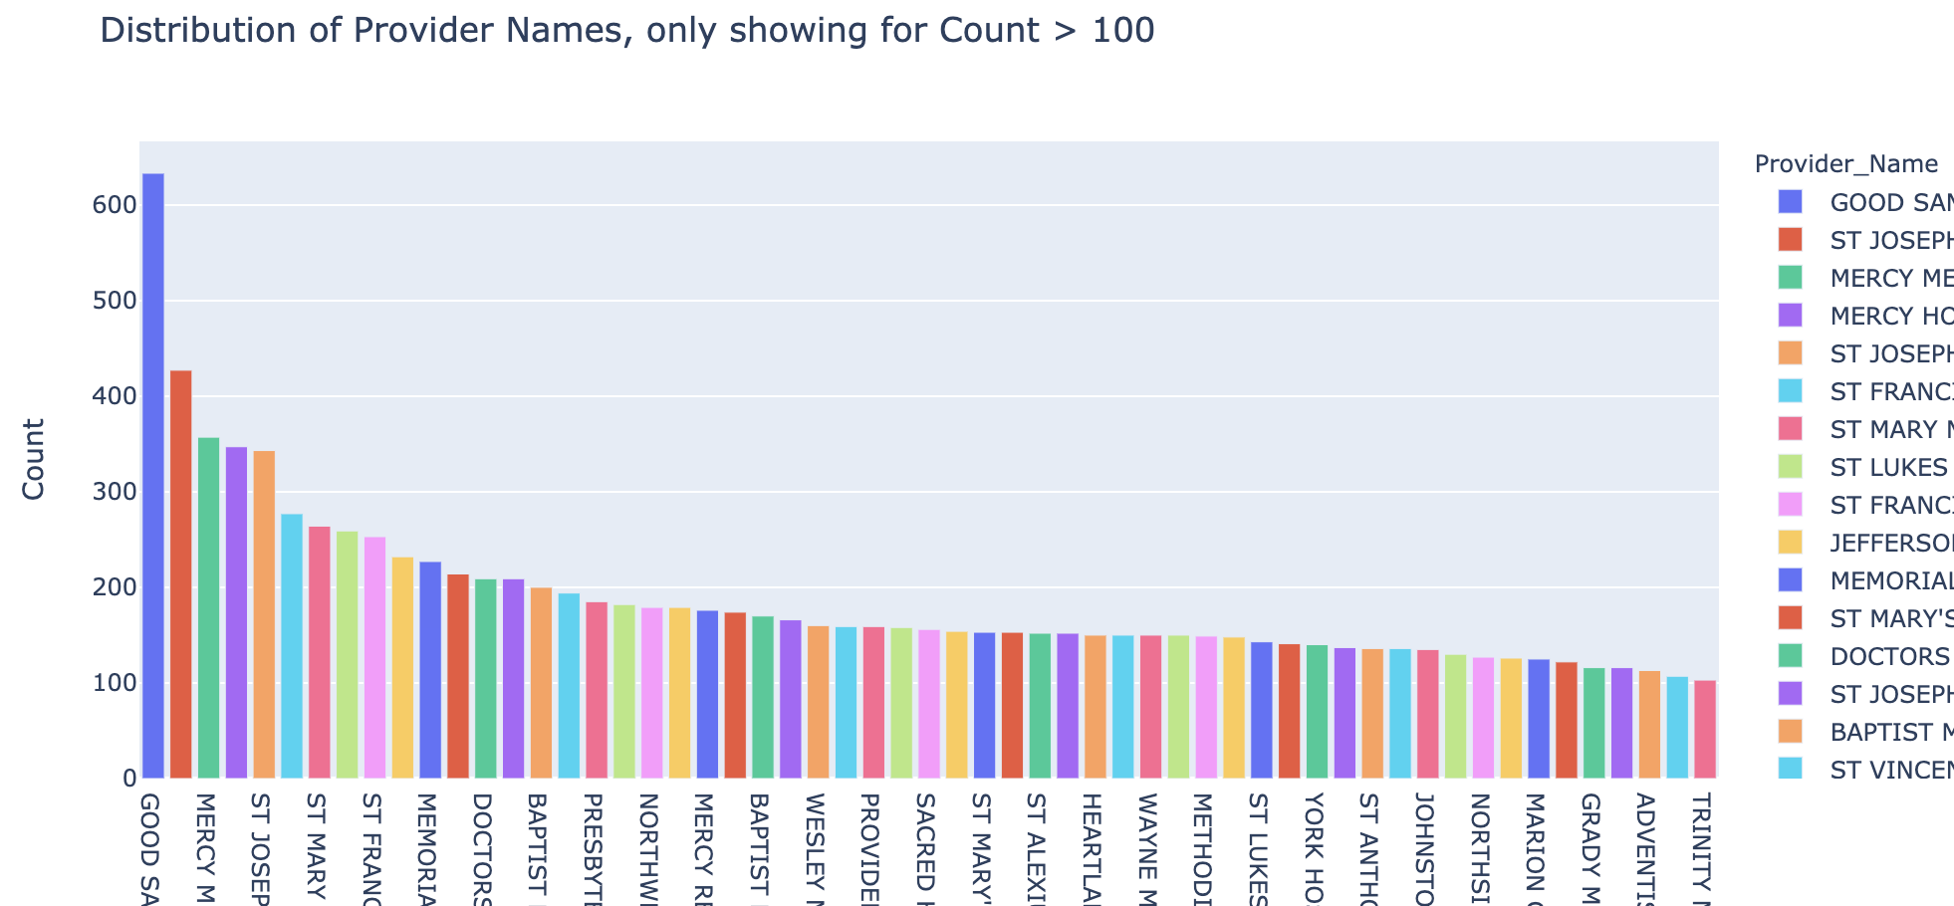
5420 Anomaly Detection, Fall 2020
- Harsh Dhanuka, hd2457
Initial Approach to data
Initial Data Cleanup
Rename columns, drop ‘amount covered’ column
Convert amount columns to numeric format.
Map zipcode variable, to zipcode dataset
Add ‘States’ dataset to map according to regions
Exploratory Data Analysis
1
DRG Definitions
2
Provider Names

Slide 6
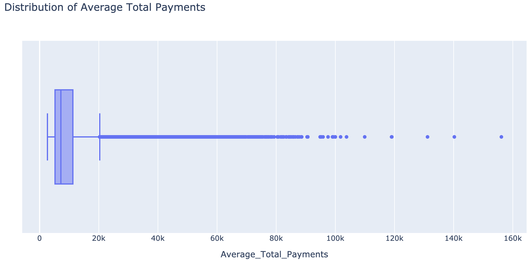
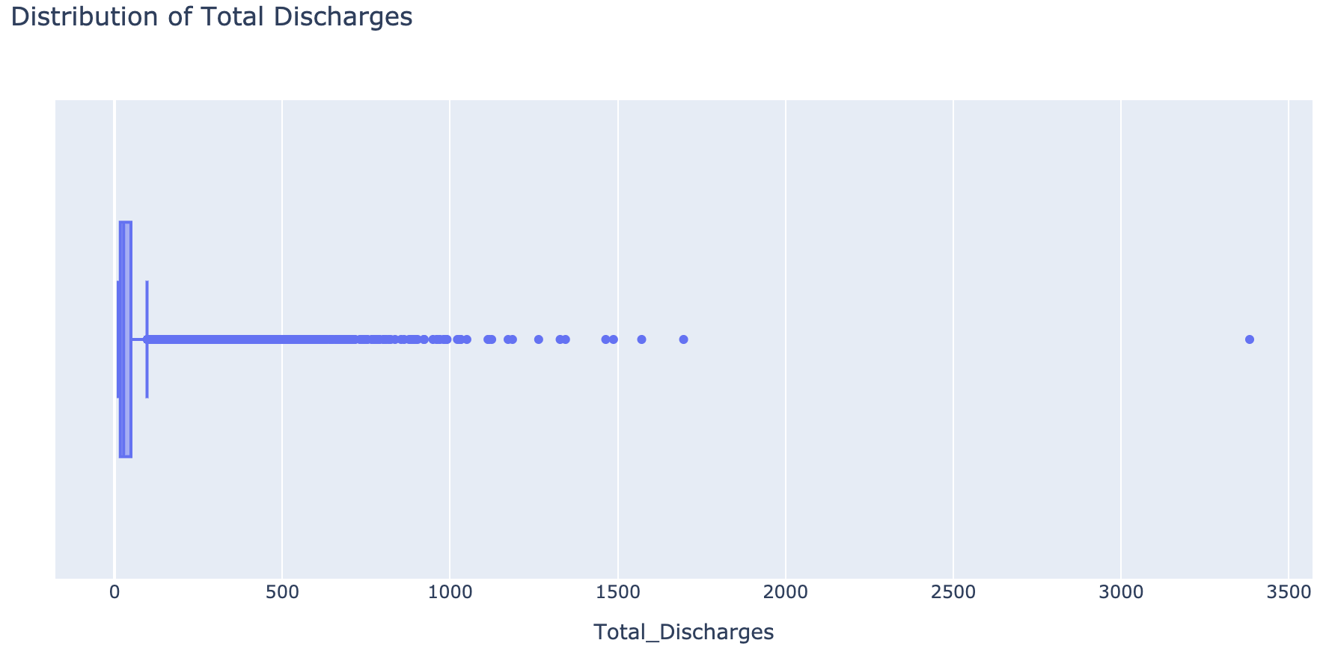
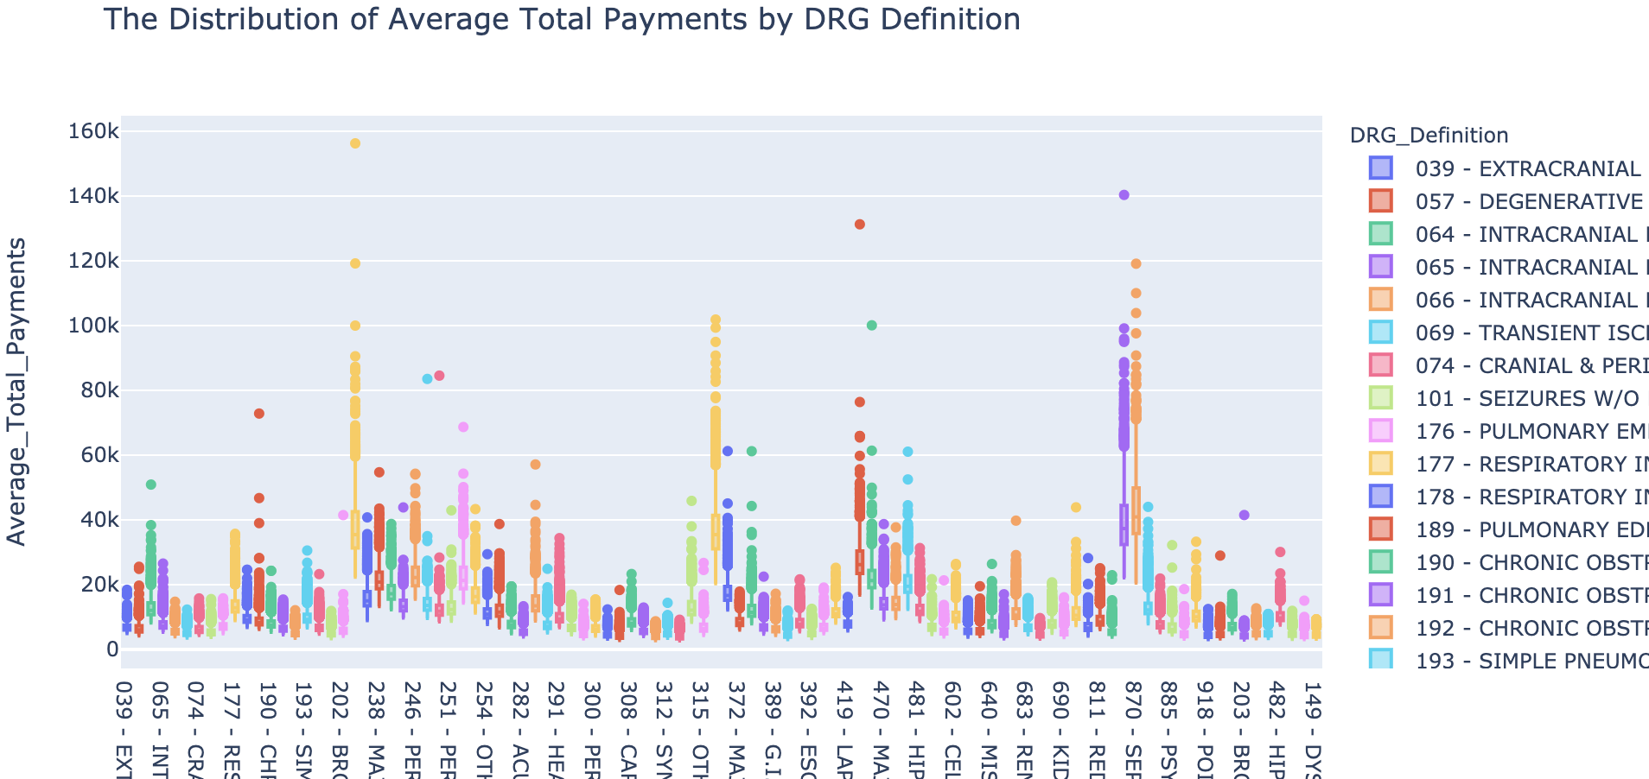
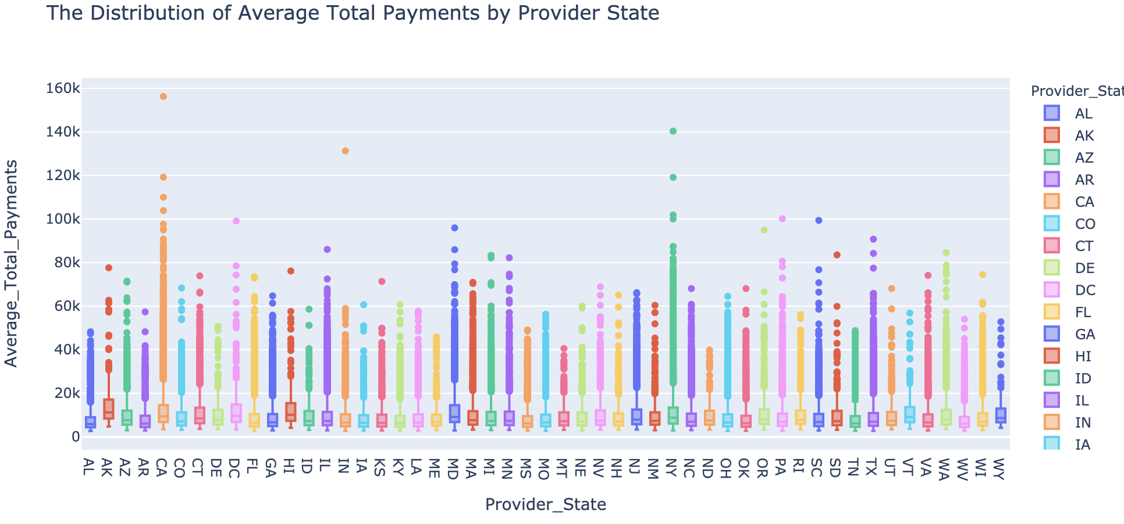
5420 Anomaly Detection, Fall 2020
- Harsh Dhanuka, hd2457
Exploratory Data Analysis
3
Average Total Payments
4
Total Discharges
5
Average Total Payments by DRG
6
Average Total Payments by State

Slide 7
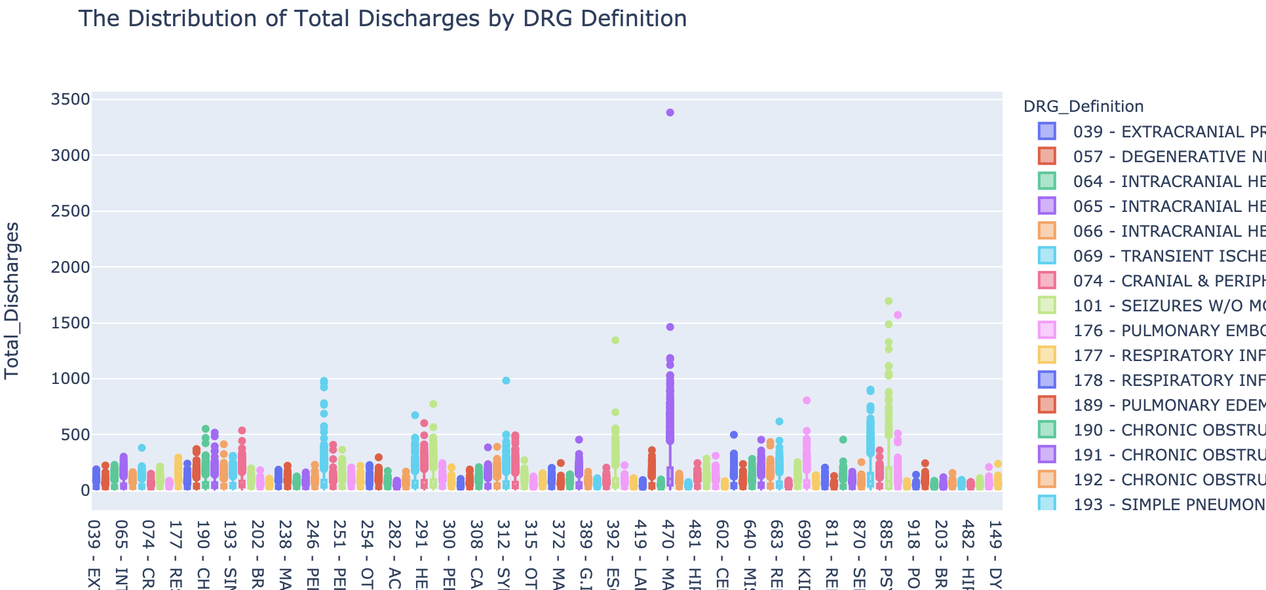
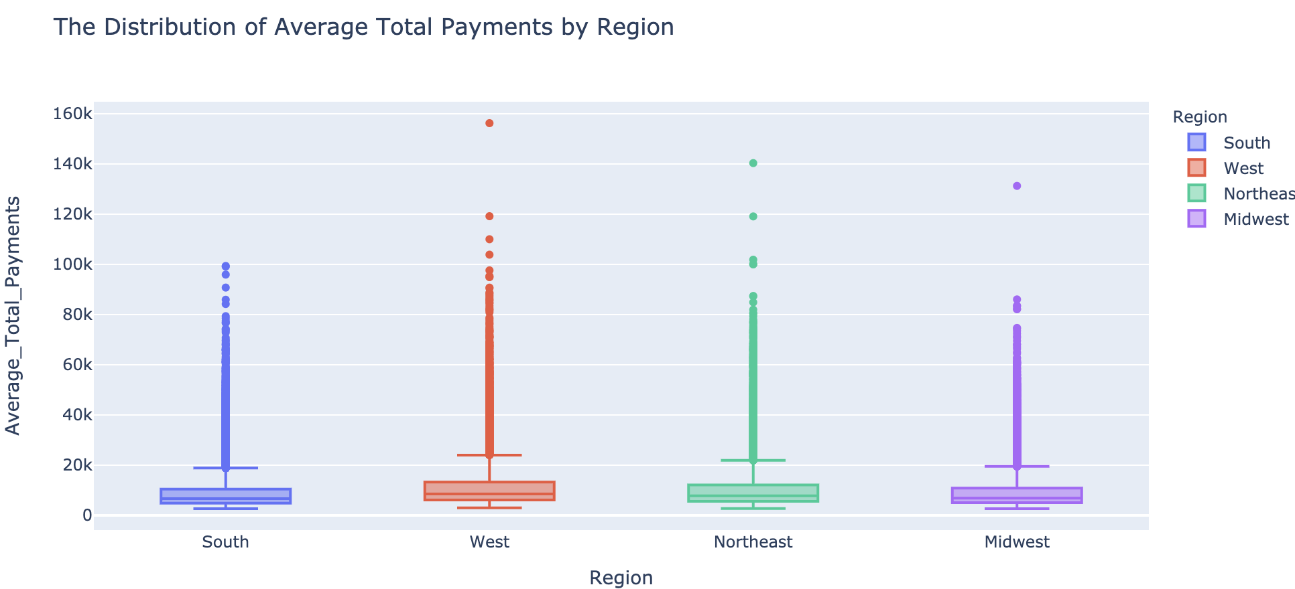
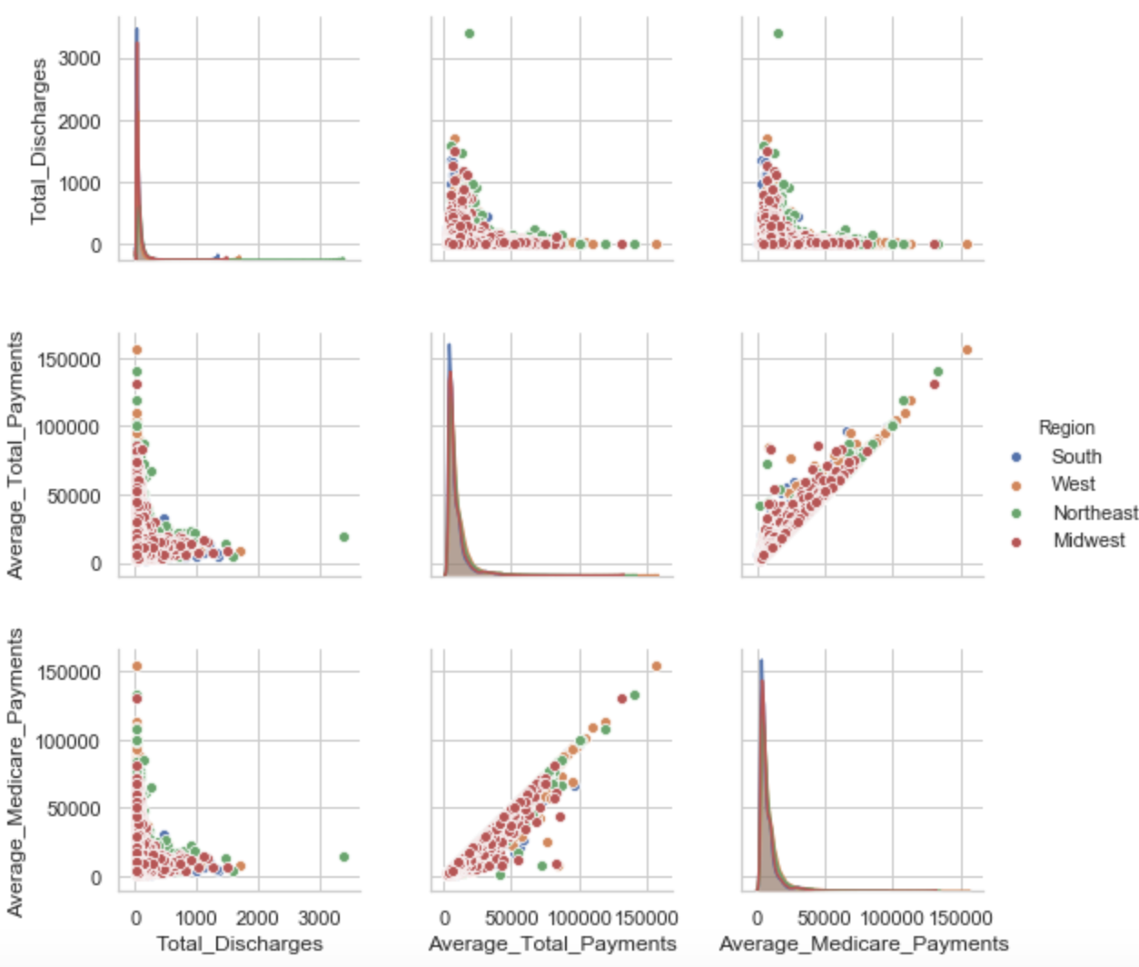
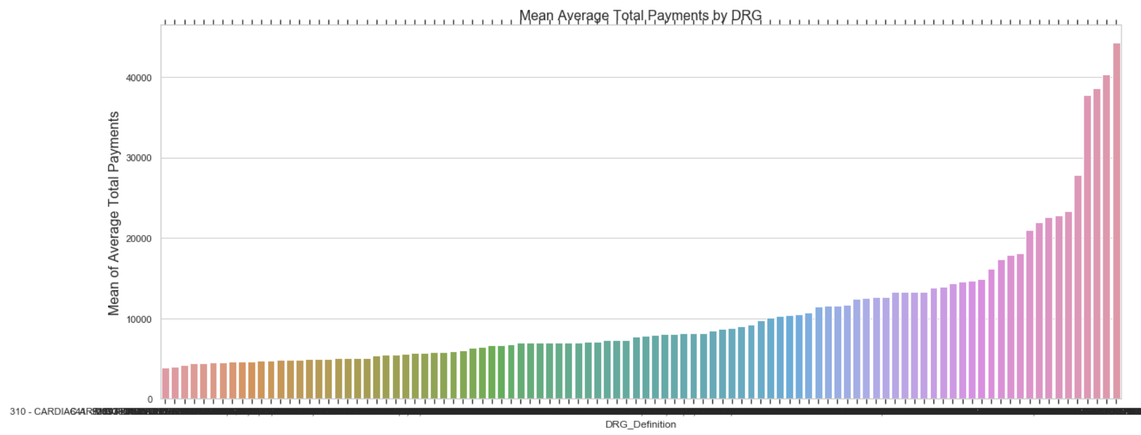
7
Total Discharges by DRG
8
Average Total Payments by Region
9
Numerical Variables by Region
10
Mean of DRG Groups

Slide 8
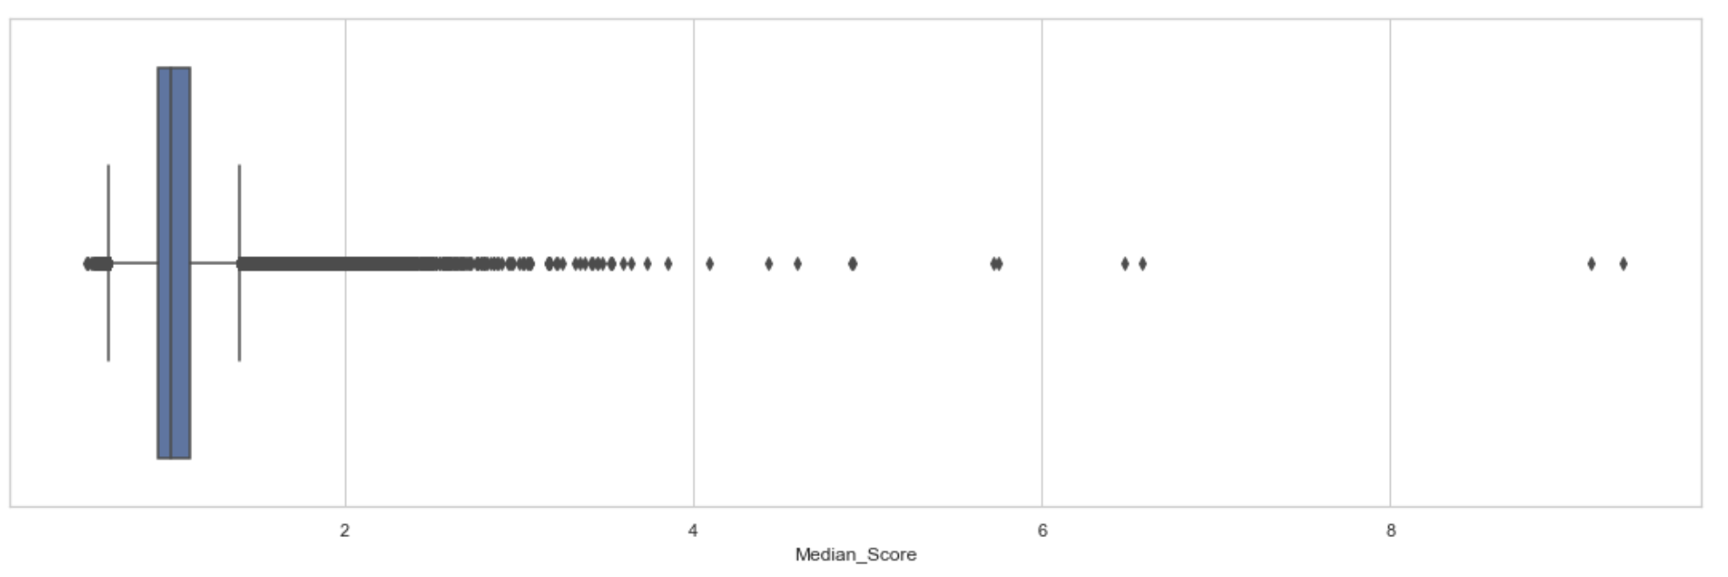
5420 Anomaly Detection, Fall 2020
- Harsh Dhanuka, hd2457
Feature Engineering
I created 14 new features, and also demonstrated how to identify a suspect hospital
1
Median Score
Float of Average Total Payments over Median of Average Total Payments grouped by DRG & State
2
Median Score by Provider
Create Boolean Flag if score > 2
3
Out-of-Pocket expenses
Difference between 'Average Total Payments' & 'Average Medicare Payments'
4
Medicare Payments, converted to % of Average Total Payments, State-wise
States with higher percentage of medicare payouts are more susceptive to fraud
5
Average cost per procedure or treatment
The percentage of Average Total Payments by Total Discharges

